Slide 1
Team A Project
BI & Data Warehouse
Group Member:
Carina Meng
Pristen Anton Patil
Terry Chou
22 Feb, 2024

Slide 2
1. PROJECT DESCRIPTION
Utilizing advanced data extraction techniques to gather insights from New York City taxi cab data.
Employing cutting-edge data transformation methods to prepare the data for analysis and visualization.
Applying sophisticated analytical techniques to uncover patterns and trends that can drive operational efficiency and business growth.
Leveraging modern technologies and tools to develop a robust business intelligence solution tailored to specific business needs.
Notes:
Our project focuses on leveraging New York City taxi cab data to develop a practical business intelligence solution, inspired by modern technologies. By diving into this extensive dataset, our goal is to extract valuable insights that can optimize operations, enhance user experience, and fuel business growth. We'll be diving deep into the data, working on extraction, transformation, and analysis to cater to specific business needs.

Slide 3
2. WHAT IS THE FINAL GOAL OF THE PROJECT
Delivering actionable intelligent insights derived from the analysis of NYC taxi data.
Streamlining decision-making processes by addressing key business intelligence questions and visualizing trends.
Boosting operational efficiency within the taxi service ecosystem for both users and drivers.
Ensuring a smoother experience for all stakeholders through the implementation of data-driven solutions.
Notes:
The ultimate aim of our project is to provide an actionable intelligent insight derived from the analysis of NYC taxi data. Through addressing key business intelligence questions and visualizing trends, our objective is to streamline decision-making processes, boost operational efficiency, and ensure a smoother experience for users and drivers within the taxi service ecosystem.

Slide 4



3. Software used & Target DW Database
Postgresql
Python
Tableau
Google Colab
Postgresql > Data_Warehouse > Tables

Slide 5
4. DATA & DATA SOURCE
Main Source:
New york Taxi Cab Data (Green)
External Data:
Geographical data of NYC
Coordinates of each zone in NYC
(https://data.cityofnewyork.us/Transportation/NYC-Taxi-Zones/d3c5-ddgc)
Taxi Zone Lookup Table (Names of Each Zone)
Name of each zone and Borough
(https://data.cityofnewyork.us/Transportation/NYC-Taxi-Zones/d3c5-ddgc)

Slide 6
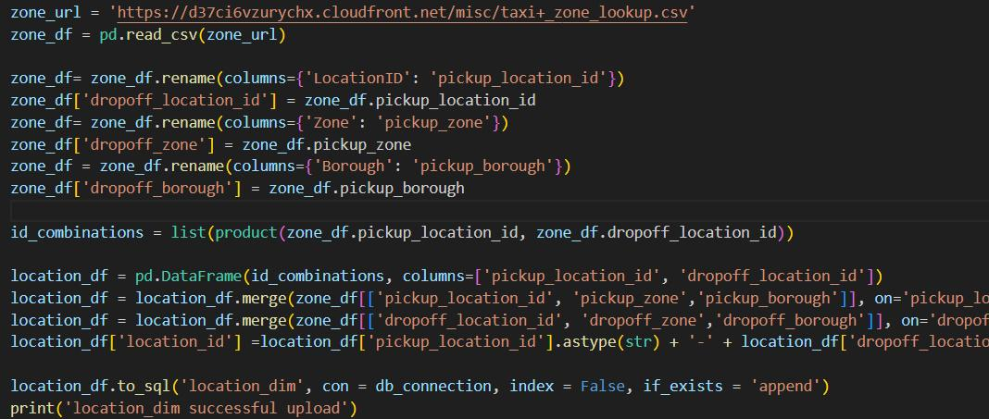
5. ETL – Location Dimension
Result: 7 columns & 70225 rows
Not expected to increase
Notes:
Extract phase – Set starting year & month
Notes from professor: more detailed
Extract data using url → update yr & mon in by the end of every loop
Reaches target year and month

Slide 7
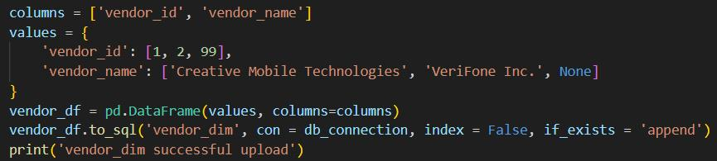
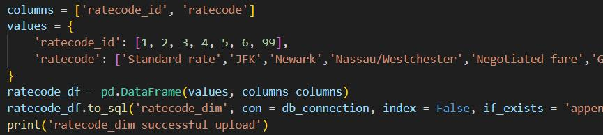
5. ETL – Vendor, Rate Code Dimension
Result: 2 columns & 3 rows
Not expected to increase
Result: 2 columns & 7 rows
Not expected to increase
Notes:
Extract phase – Set starting year & month
Notes from professor: more detailed
Extract data using url → update yr & mon in by the end of every loop
Reaches target year and month

Slide 8
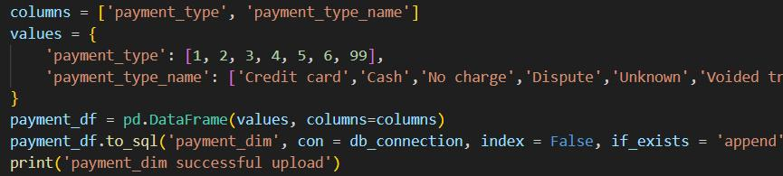
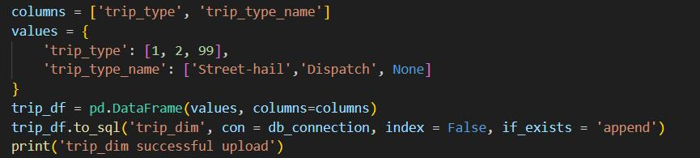
5. ETL – Payment Type, Trip Type Dimension
Result: 2 columns & 7 rows
Not expected to increase
Result: 2 columns & 3 rows
Not expected to increase
Notes:
Extract phase – Set starting year & month
Notes from professor: more detailed
Extract data using url → update yr & mon in by the end of every loop
Reaches target year and month

Slide 9
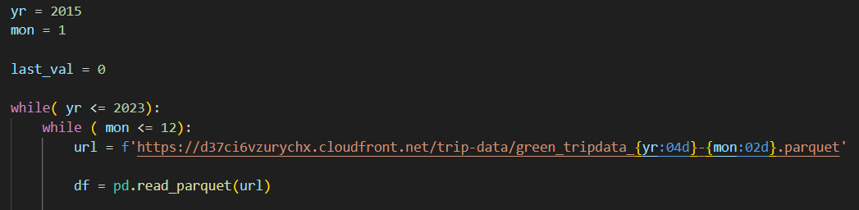
5. ETL (Extraction)
Extract data by month
Start: 01/2015
Increment by one month until no more data is found
End:12/2023
Notes:
Extract phase – Set starting year & month
Notes from professor: more detailed
Extract data using url → update yr & mon in by the end of every loop
Reaches target year and month

Slide 10
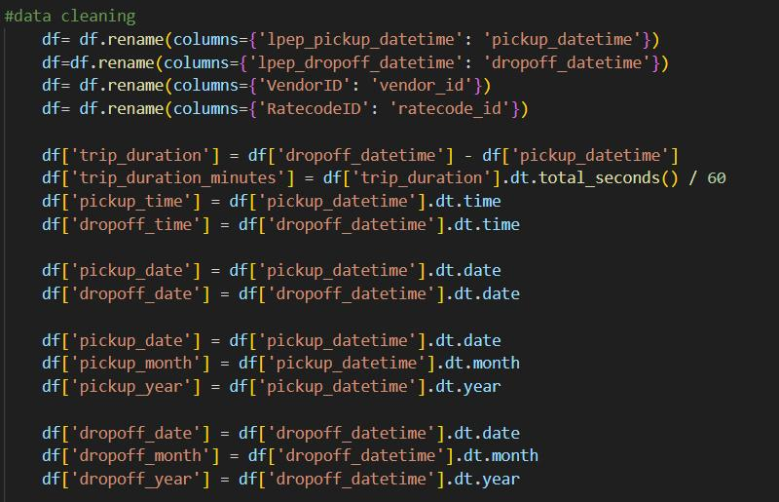
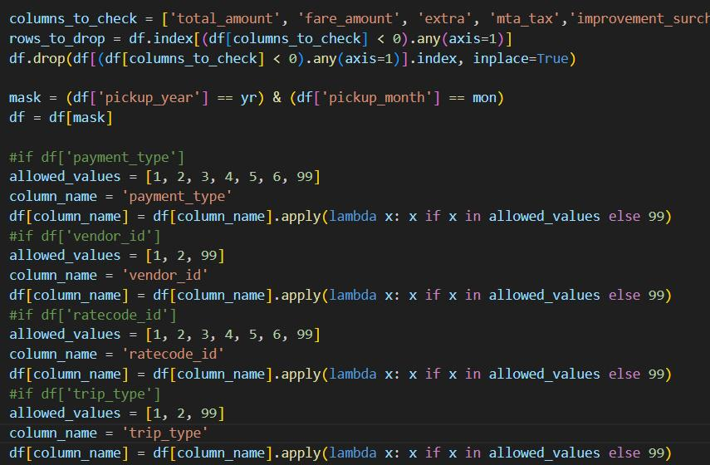
5. ETL (Cleaning & Transformation) Part 1
Remove 50% of data from each month
Rename columns
Calculate trip duration in minutes
Drop error values
Negative fees
Undefined code
Wrong dates
Notes:
Focus on normalization

Slide 11
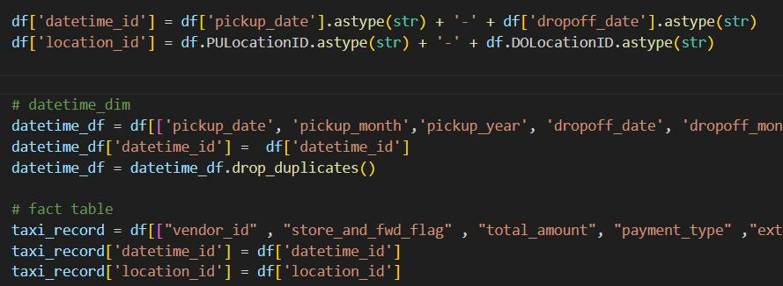
5. ETL (Cleaning & Transformation) Part 2
Construct Keys
datetime_id: pickup_date–dropoff_date
location_id: pickup_location_code–dropoff_location_code
Construct fact table & datetime dimension

Slide 12
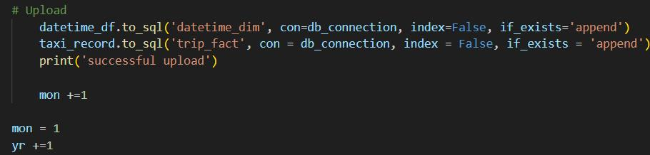
5. ETL (Load)
Upload to database
Fact table:
19 columns & 33419470 rows (will increase by total number of trips every month)
Datetime Dimension:
7 columns & 6608 rows (will increase by roughly 61 rows every month)

Slide 13
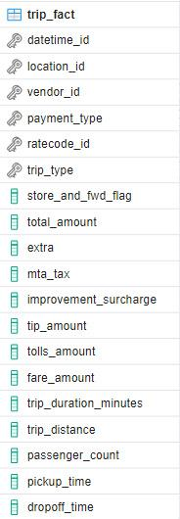
6. Star Schema - Fact Table
datetime_id: pickup_date–dropoff_date
location_id: pickup_code–dropoff_code
vendor_id: vendor code
payment_id: payment code
ratecode_id: rate code
trip_type: trip code
Foreign Keys
pickup_time: hr-min-sec
dropoff_time: hr-min-sec
Quantitative Measures

Slide 14
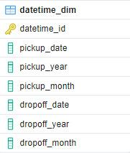
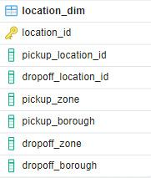
6. Star Schema - Dimension Tables
Datetime Dimension
datetime_id: pickup_date–dropoff_date
Trip_1
Trip_2
Trip_3
…
id
Location Dimension
location_id: pickup_loc–dropoff_loc
Trip_X
Trip_Y
Trip_Z
…
id

Slide 15
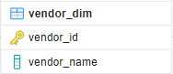
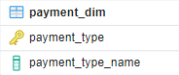
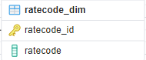
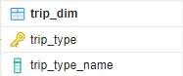
6. Star Schema - Dimension Tables
Vender
Dimension
Payment Dimension
Ratecode Dimension
Trip
Dimension

Slide 16
Fact & Dimensions

Slide 18
6. Star Schema - Normalization
Our star schema design adheres to the Third Normal Form (3NF), which ensures that the database is free from insertion, update, and deletion anomalies. In 3NF:
In our schema:
Dimension Tables
PK uniquely identifies each record (e.g., datetime_id, location_id, vendor_id, etc.).
Non-key attributes are fully functionally dependent on PK,
No transitive dependencies.
Fact Table (trip_fact)
Contains foreign keys which reference the primary keys of the dimension tables, ensuring referential integrity.
Measures are directly related to the fact table keys (total_amount, trip_duration_minutes, and passenger_count)
No transitive dependencies in the fact table – attributes are either part of the composite key or are measures directly related to the business process.
Notes:
in the datetime_dim table, attributes like pickup_year, pickup_month, and pickup_date are directly dependent on datetime_id.

Slide 19
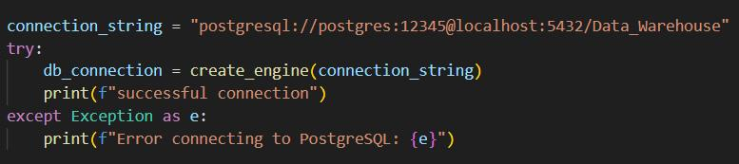
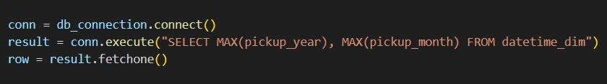

7. Incremental Update
Connect to the database
Connect to the database
Look up most recent year & month combination from DB
Look up most recent year & month combination from DB
Increment by 1 month
Increment by 1 month

Slide 20
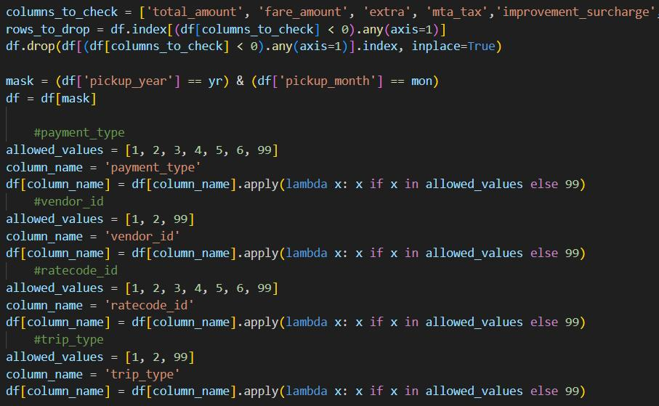
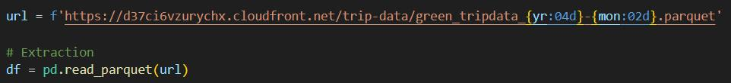
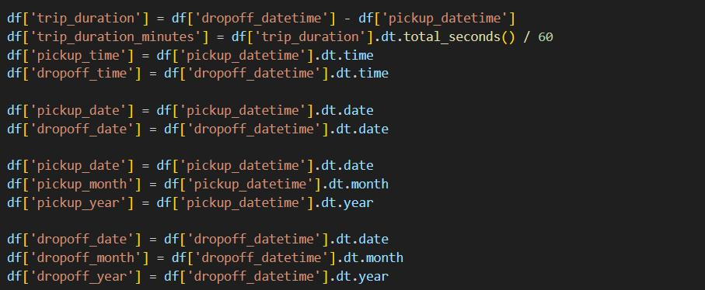
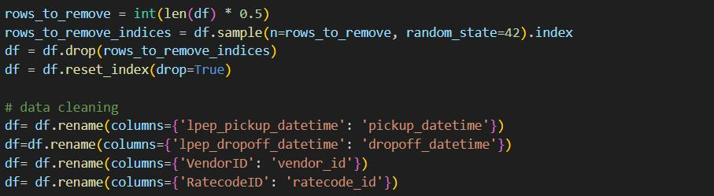
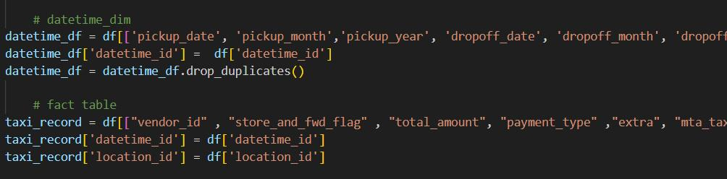
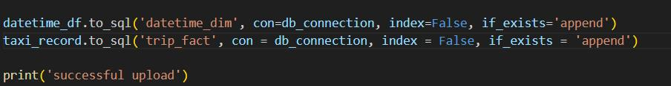
7. Incremental Update
Data Extraction
Data Extraction
Same data transformation
Same data transformation
upload
upload

Slide 21

8.1 Business Intelligence (End users of DW)
Senior executives
Customers
Taxi Drivers
Notes:
Customers: trip details
SENIOR EXECUTIVES: high-level insights of business performance track key performance indicators

Slide 22
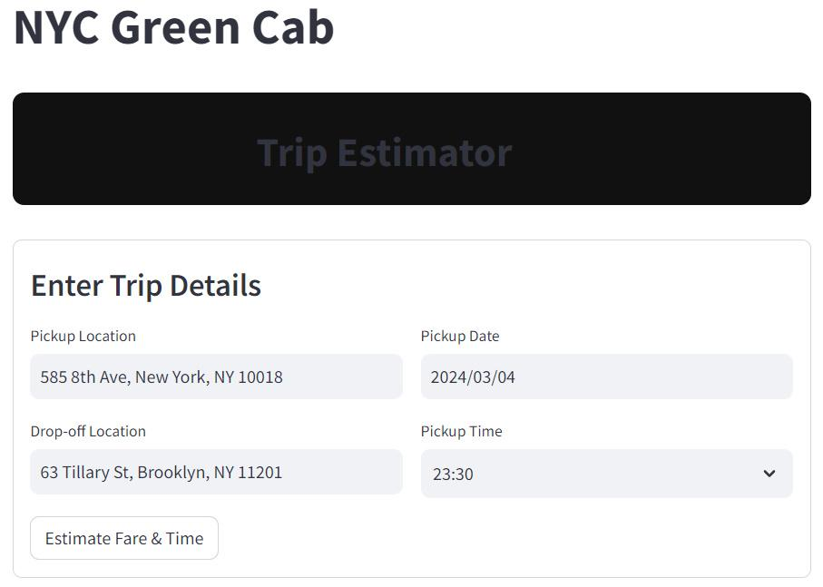
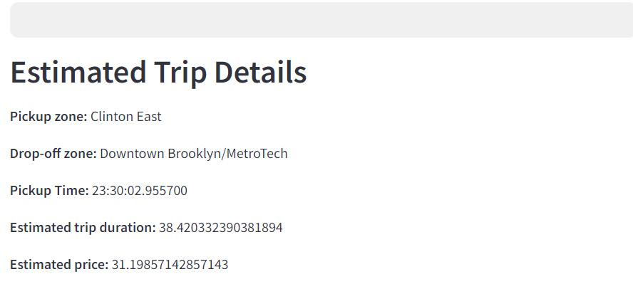
8.2 BI SQL queries
Q1. Estimate Trip Duration/Amount for Customers
Determine the zones for pick up & drop off location
Notes:
Minimum ⅓ of the time to do BI

Slide 23
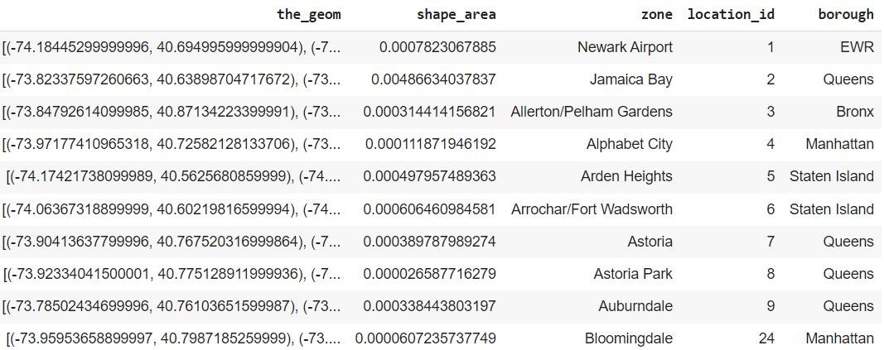

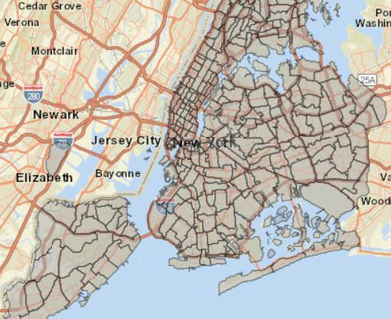
8.2 BI SQL queries
https://data.cityofnewyork.us/Transportation/NYC-Taxi-Zones/d3c5-ddgc
Notes:
Minimum ⅓ of the time to do BI

Slide 24
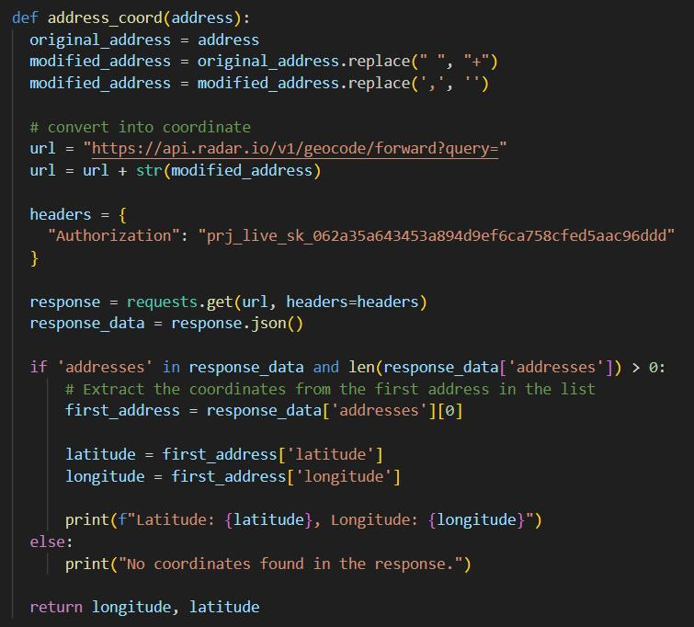
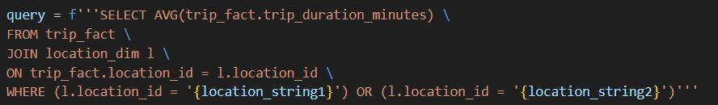
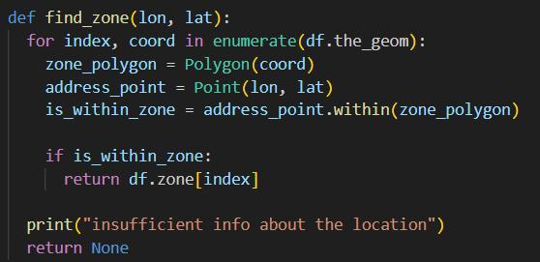
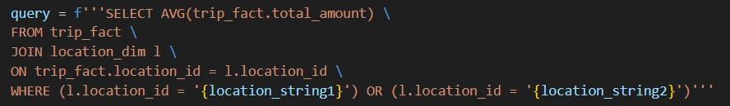
8.2 BI SQL queries
Address(str)
Radar API
Longitude & Latitude
shapely
Zone Latitude & Longitude
Notes:
Minimum ⅓ of the time to do BI

Slide 25
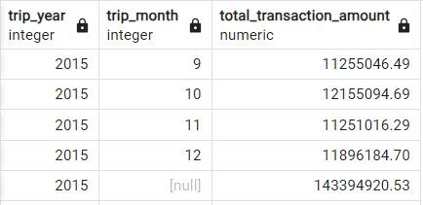
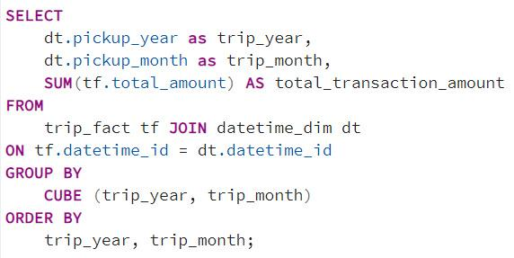
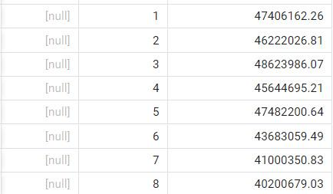
8.2 BI SQL queries
Q2. Seasonality/yearly trends → (Senior Executives) business monitor
OLAP: Roll up
Notes:
Minimum ⅓ of the time to do BI

Slide 26
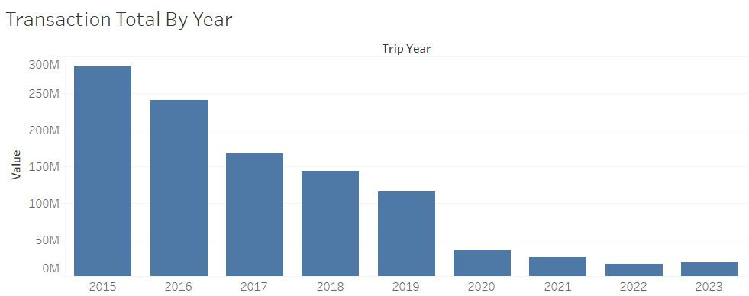
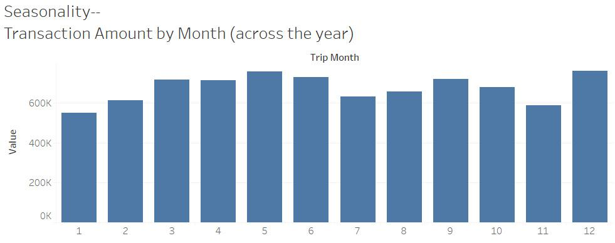
8.2 BI SQL queries
Yearly Total
Cab Demand decreases over the years
Monthly Total (Seasonality)
Peak Month:
May & December
Notes:
Minimum ⅓ of the time to do BI

Slide 27
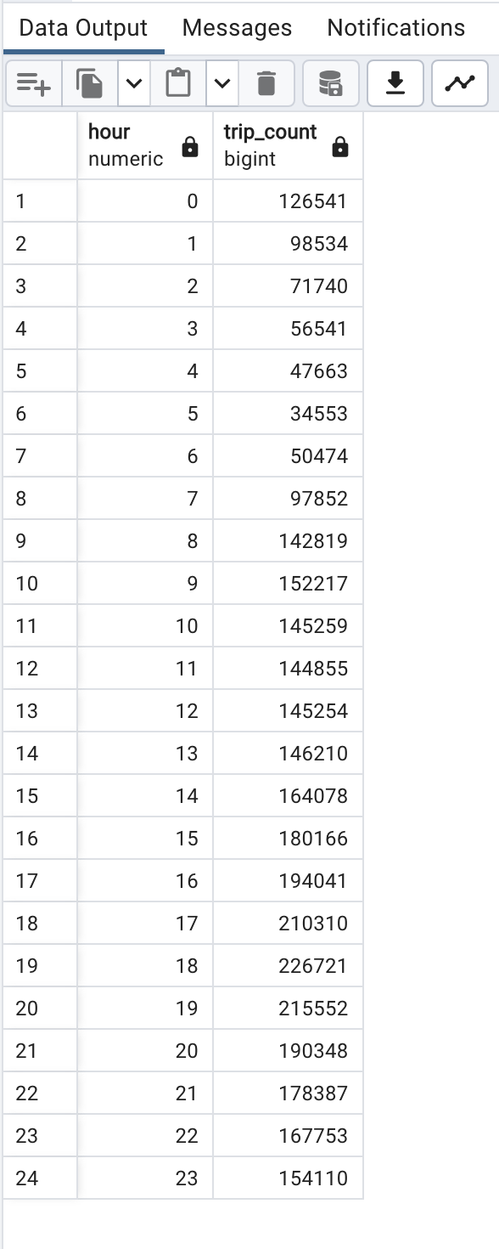
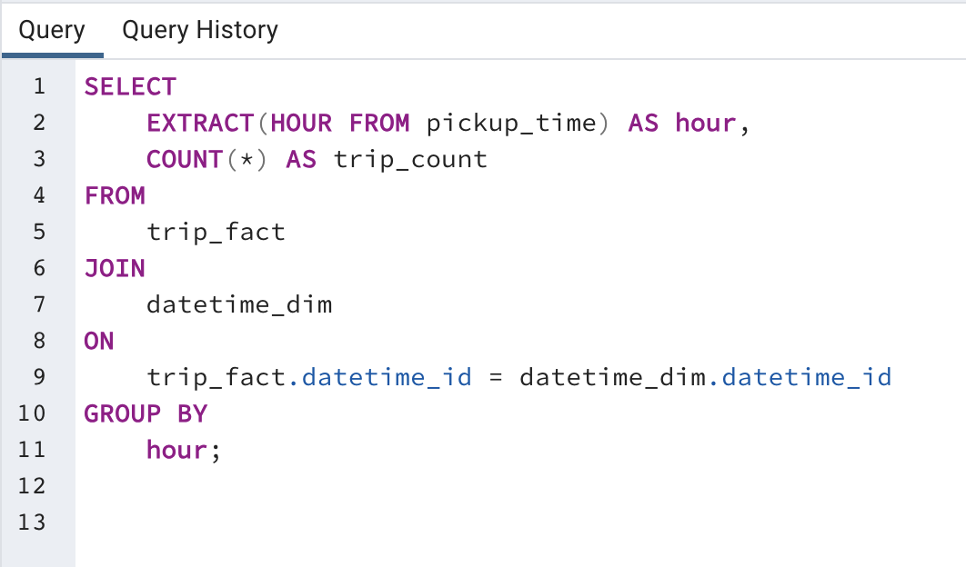
8.2 BI SQL queries
Q2. Busiest time of the day ( sum_trip_id max)
2. Busiest Hour
Notes:
Minimum ⅓ of the time to do BI

Slide 28
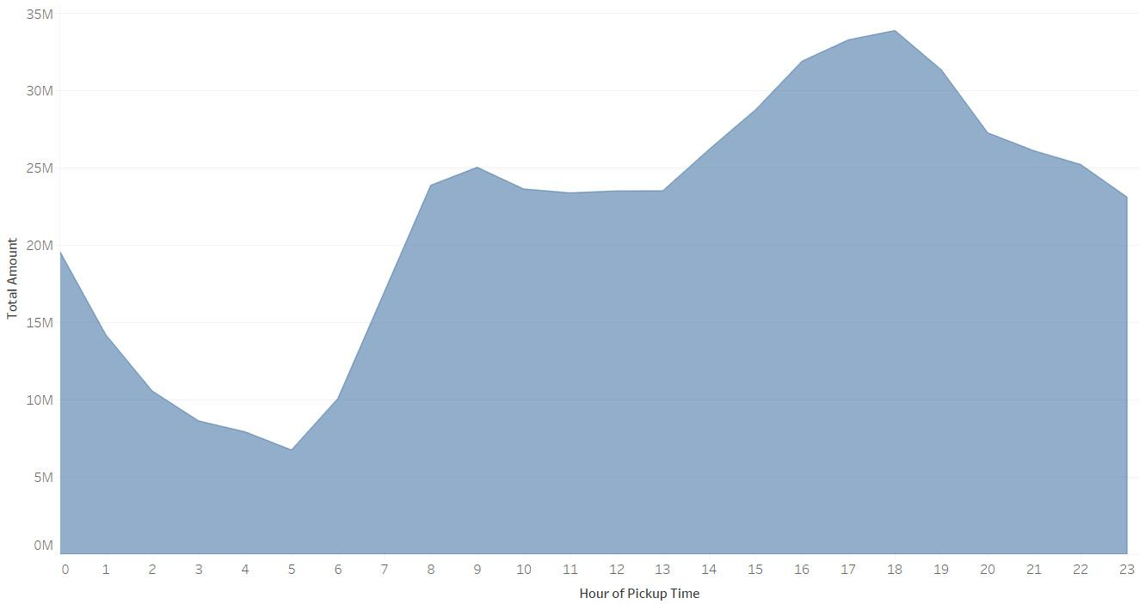
8.2 BI SQL queries
Q2. Busiest time of the day ( sum_trip_id max)
Least Busy hour:
4am - 6am
Busiest hour:
3pm - 8pm
Notes:
Minimum ⅓ of the time to do BI

Slide 29
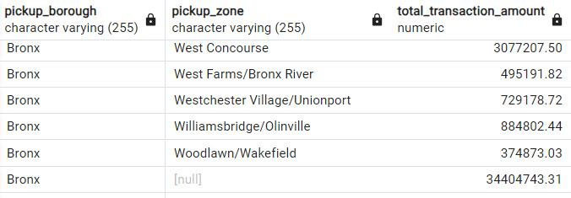
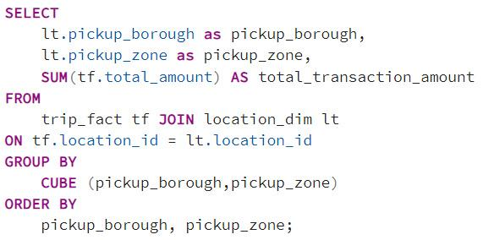
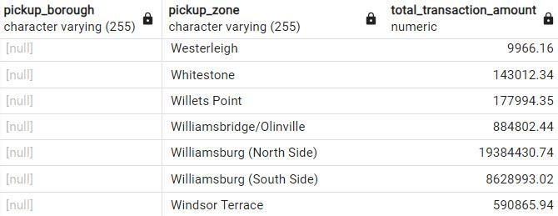
8.2 BI SQL queries
3. Ride sharing Promotion? (Point A - Point B + estimated pickup time) → (Customers)
OLAP: Roll-up
Notes:
Minimum ⅓ of the time to do BI

Slide 30
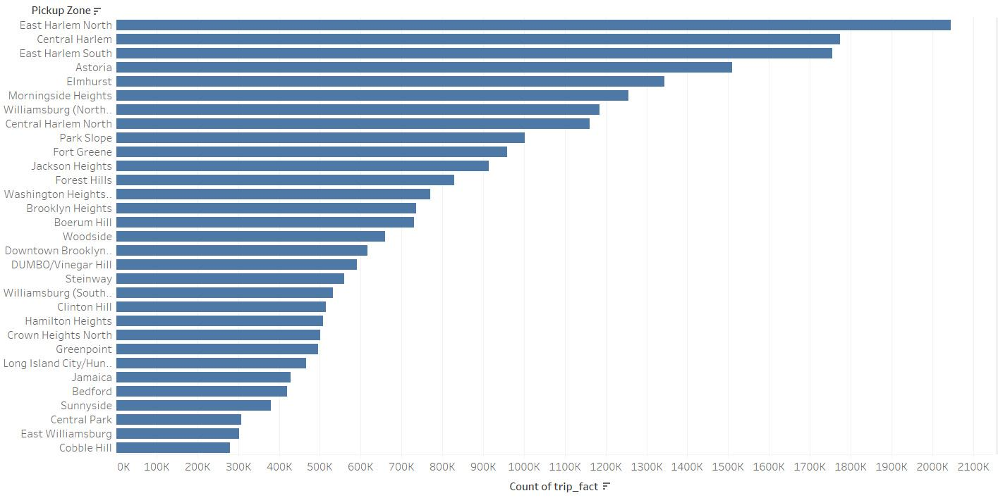
8.2 BI SQL queries
Busiest Zone: Eastern Harlem North
Notes:
Minimum ⅓ of the time to do BI

Slide 31
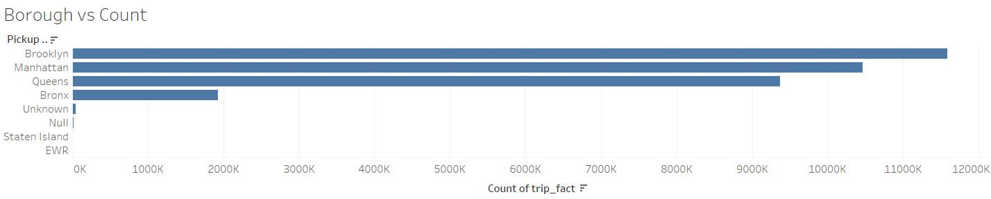
8.2 BI SQL queries
Most Profitable Borough: Brooklyn
Notes:
rollup

Slide 32
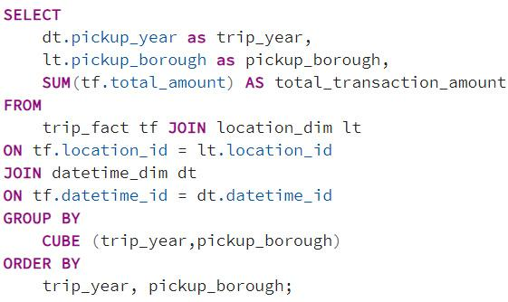
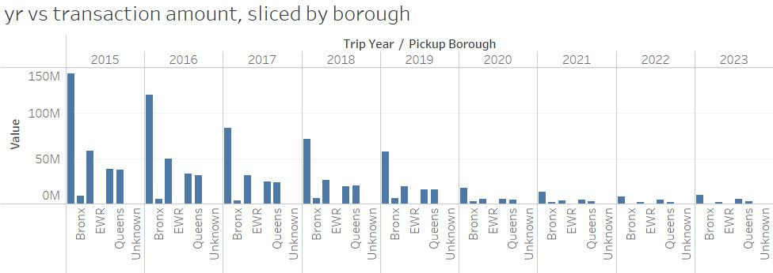
8.2 BI SQL queries
Slice the Yearly Trend by Pickup Borough
Notes:
rollup

Slide 33
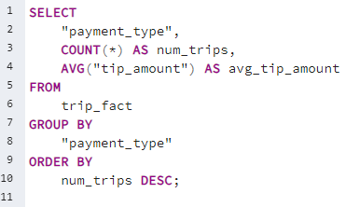
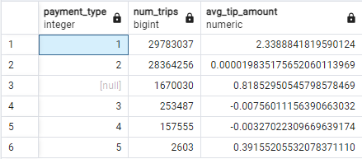
8.2 BI SQL queries
Q4. Payment analysis → (Senior Executives)
Tips amount based on payment type
Findings:
Most used payment type is type 1, credit card
Payment type 2, Cash is the 2nd popular payment type
Credit card has the highest average tip amount
Notes:
Minimum ⅓ of the time to do BI

Slide 34
Summary
Challenges:
Slow ETL process due to large dataset
Star Schema redesign
Catching and fixing error data
Learning:
Be smart with extracting data, and extract only the needed amount of data
Finalize the business requirements and key metrics before designing star schema
Utilize google Colab for better GPU and compute
How we can do this better for next classes:
More Data Visualization technologies
More Detailed Feedback for the 12 Minute Presentations
Integrating a bit of ML

Slide 35
Thank you!
Notes:
Notes from professor:
more detailed ETL
Minimum ⅓ of the time to do BI
Focus on normalization
FOR external data, add url and explanation
Use rollup

